Slide 1
Thesis Defence
Hassan Ali Khan – MS-CS’15
LUMS

Slide 2
Problem Statement
How to enable the transiently powered device to retain it’s computational state across multiple activation cycles?
Conventional Approach:
To save the complete state of RAM and registers after regular intervals
Drawbacks:
Energy expensive and time consuming
Notes:
adasdasd

Slide 3
Related work
Two classes for relative work are:
1st class uses separate memory for checkpoint and normal computations
2nd class uses non-volatile memory as their only memory space
Notes:
memory space

Slide 4
Examples of 1st Class
MementOS(ASPLOS’11):
Puts the trigger for updating the checkpoint at the end of loop iteration (loop-latch)
Decision to update the checkpoint is based on a voltage threshold(threshold is decided by repeated experiments)
Hibernus(IEEE’15):
Puts the trigger for updating the checkpoint at function return Uses FRAM
User hardware interrupt to detect if system voltage drops below the specific level
Notes:
Loop-latch and function-return techniques are used to keep the size of updates minimum thus saving the energy.

Slide 5
Examples of 2nd Class
Quick Recall:
Uses FRAM as the only program space
FRAM for both normal computations and system’s state in case of energy un-availability

Slide 6
Analysis of Current Work
MementOS, Hibernus:
Advantages: Propose optimizations as loop-latch and function-returns
Drawbacks/Limitations:
Keeps on re-writing the un-modified area of RAM in every checkpoint
Inability to affirm checkpoint’s consistency(Limited size of FRAM)
Quick Recall:
Advantages: lesser amount of data to be saved
Drawbacks/Limitations:
FRAM consumes more energy for read/write operations as compared to SRAM
Potential data-consistency issues

Slide 7
Challenges
Challenges to be addressed in checkpointing for IoT are
Minimize the number of write operations.
Right time to update the checkpoint

Slide 8
INCH- Incremental Checkpointing for Interruptible Computations
Introduction:
Computational state is only changed by a few statements
INCH instrument the source code to record memory locations before the execution of such state-modifying statements.
Offers a better tradeoff between computations and checkpointing overhead.

Slide 9
INCH Contd.
Work flow and Outputs
INCH analyzes the code statistically before execution and add the “tracking” call to the code.
On 1st execution cycle whole RAM in copied on FRAM
In later executions only the modified memory location are recorded for checkpoint update
The number of write operations are reduced due to smaller update size and incremental checkpointing.
Introduces computational overhead of tracking RAM.

Slide 10
My Role
Interface implementation
Library integration
Generating results on benchmark applications

Slide 11
Proposed Approach – INCH Contd.
TinyOS Components
nesC compiler
C-code
Inch
Instrumentation
Instrumented
C-code
msp430-gcc
Executable
Block Diagram

Slide 12
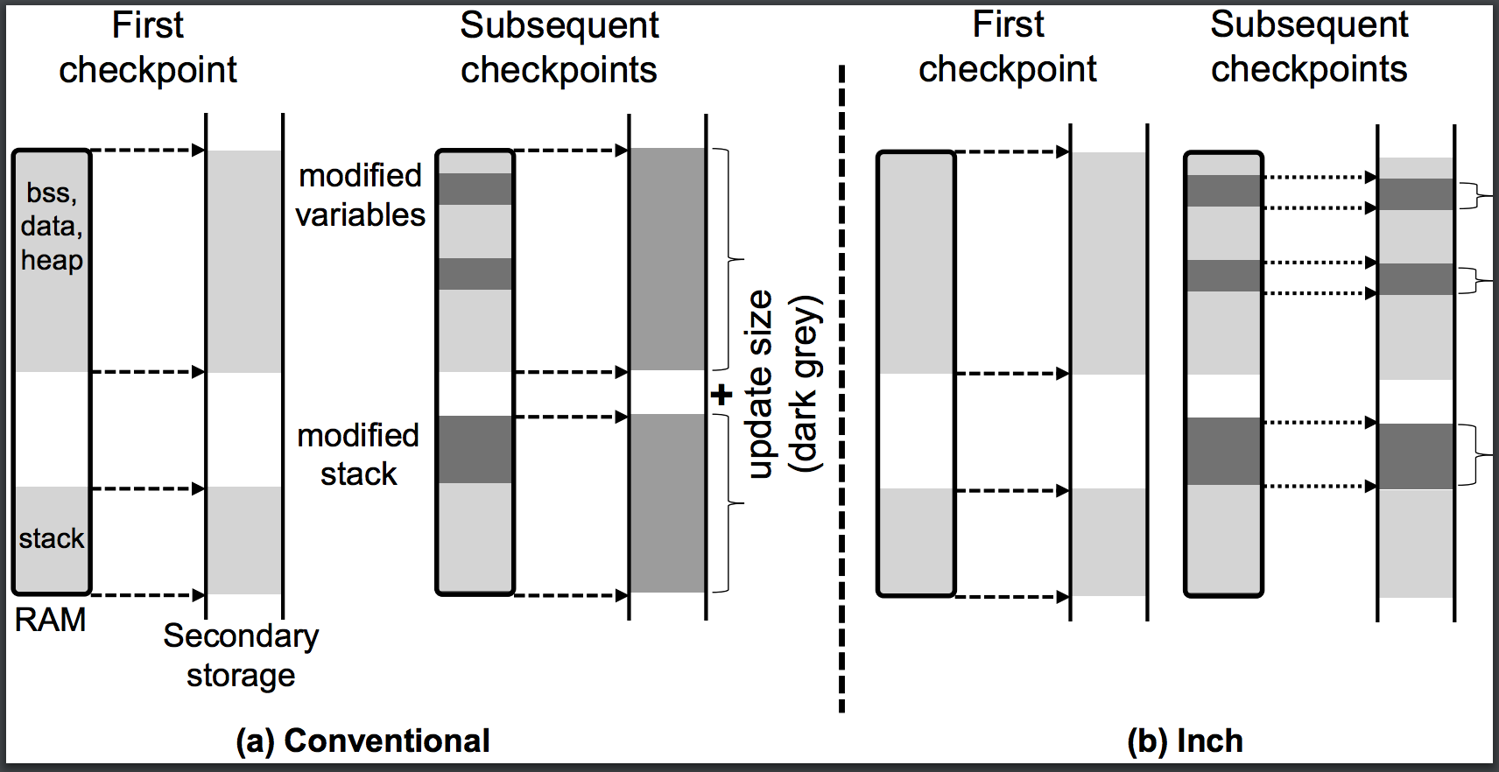
Proposed Approach – INCH Contd

Slide 13
INCH Contd.
Code Presented
int a=0,b=0; int main(){ int y=foo(x); if(y<10){ a++; } else{ b=b+1; } …
Code Instrumentation
int a=0,b=0; int main(){ int y=foo(x); if(y<10){ record(&a,sizeof(a)); a++; } else{ record(&b,sizeof(b)); b=b+1; } …
➔

Slide 14
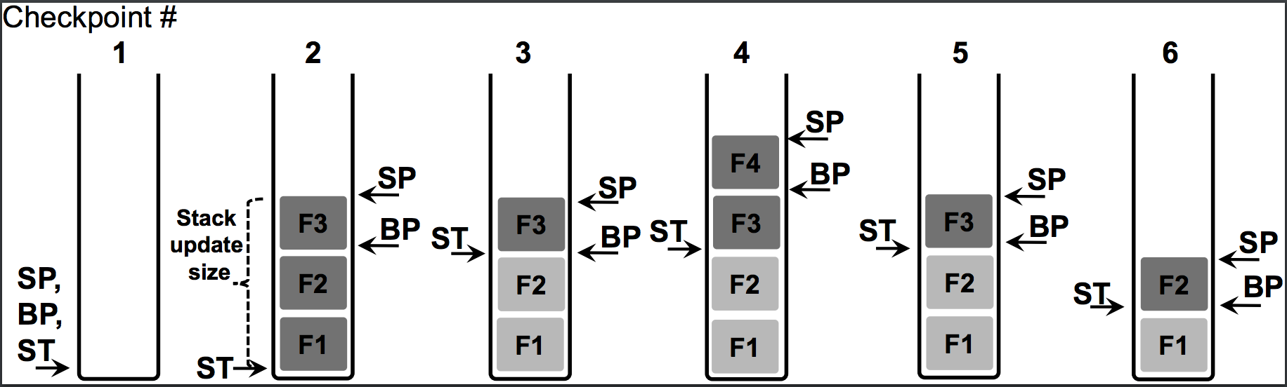
INCH Contd.
Stack Optimization:

Slide 15
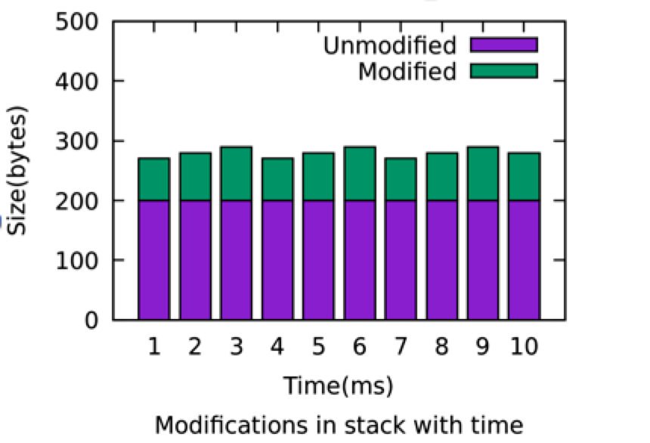
INCH Contd.
Stack Optimization:

Slide 16
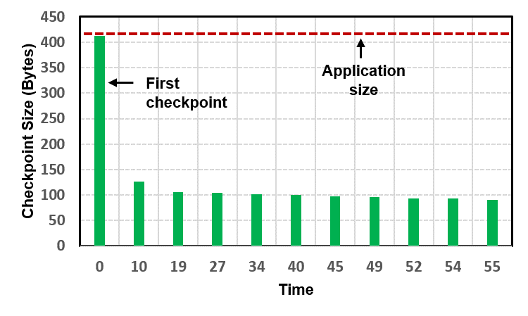
INCH-Initial Results
Checkpoint size when using an incremental approach (green bars) is significantly less than the complete application size (horizontal dotted line). This graph depicts the results of a simple TinyOS application that displays a counter, received in a packet, on the three LEDs of TelosB. The application is interrupted after every 10 seconds to checkpoint and restore its state.

Slide 17
INCH - Detailed Results
Test Applications
Sense: A typical sensing application that randomly (range: 1ms--10ms) samples a sensor, and calculates the average over an array
FFT: This application repeatedly calculates the FFT on a randomly populated (32 bit) long integer array of size 448 (1792 bytes)
RSA: This application repeatedly computes RSA over a randomly populated character array of size 2400 bytes, 60 bytes at time

Slide 18
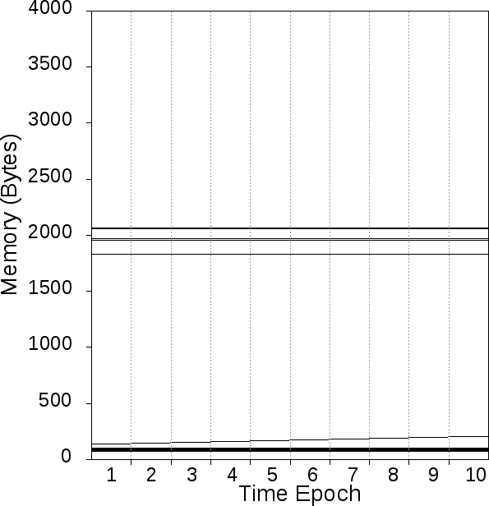
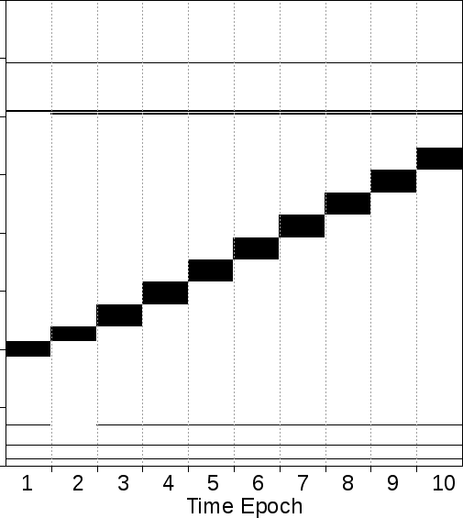
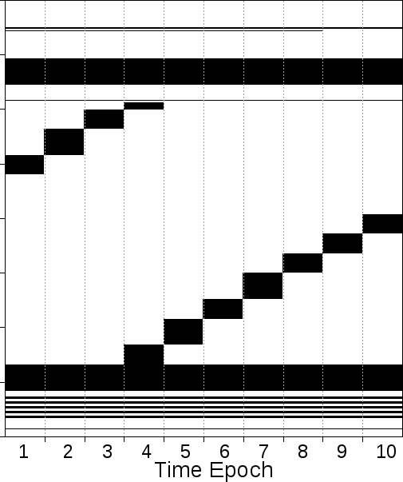
INCH - Detailed Results Contd.
Memory Updates:
Following are the bitmap representations of actual RAM updates over multiple execution,
Bitmap-Sense
Bitmap-FFT
Bitmap-RSA

Slide 19
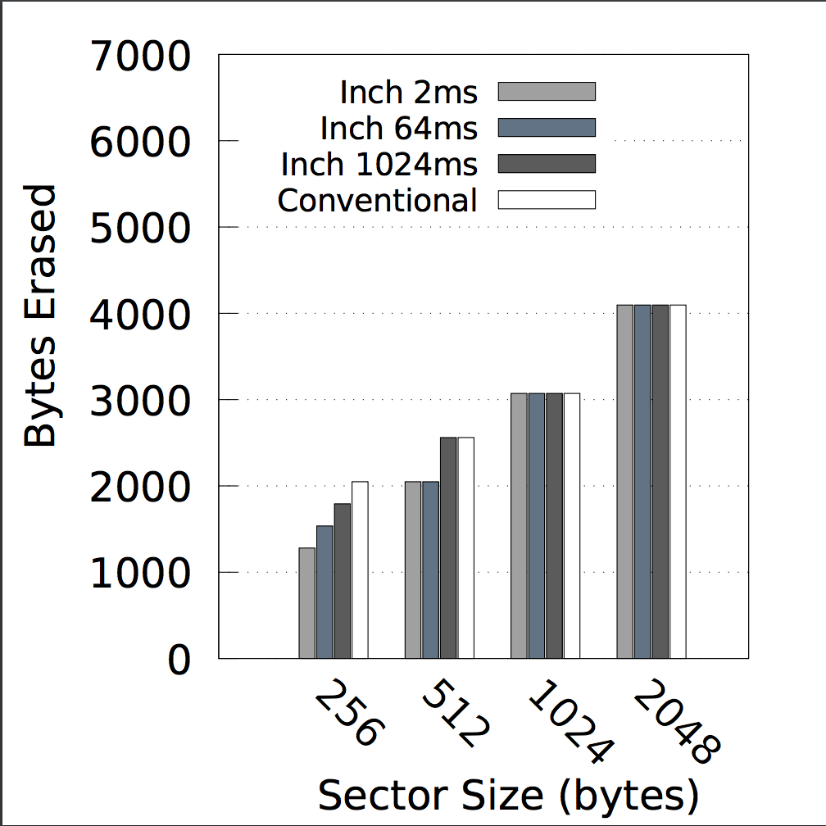
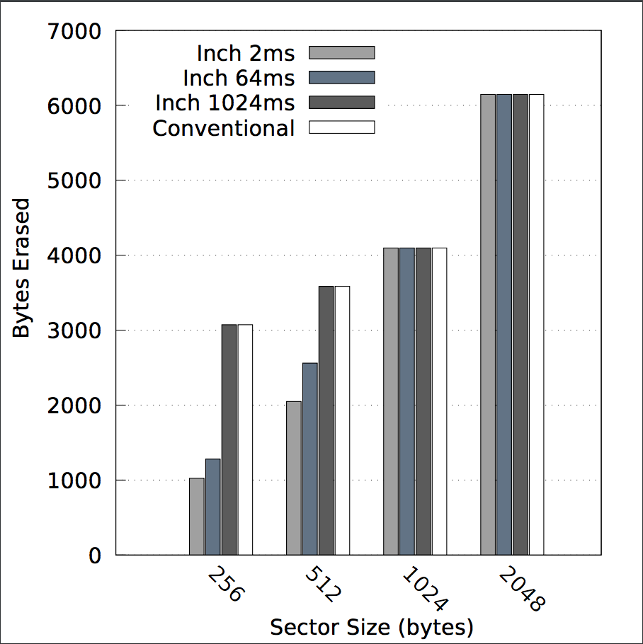
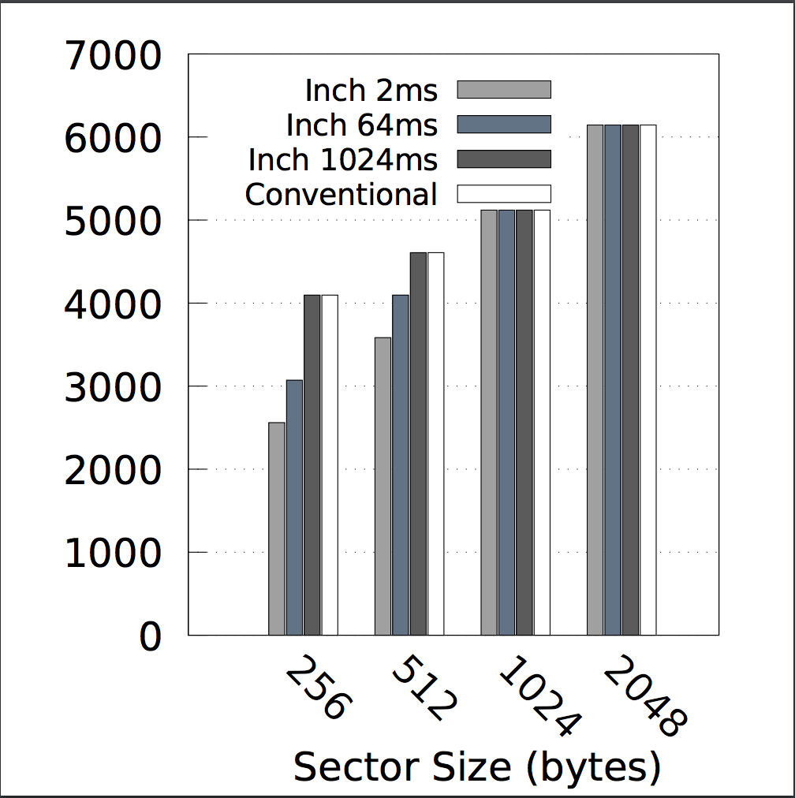
INCH - Detailed Results Contd.
Block Updates:
Blocks-Sense
Blocks-FFT
Blocks-RSA

Slide 20
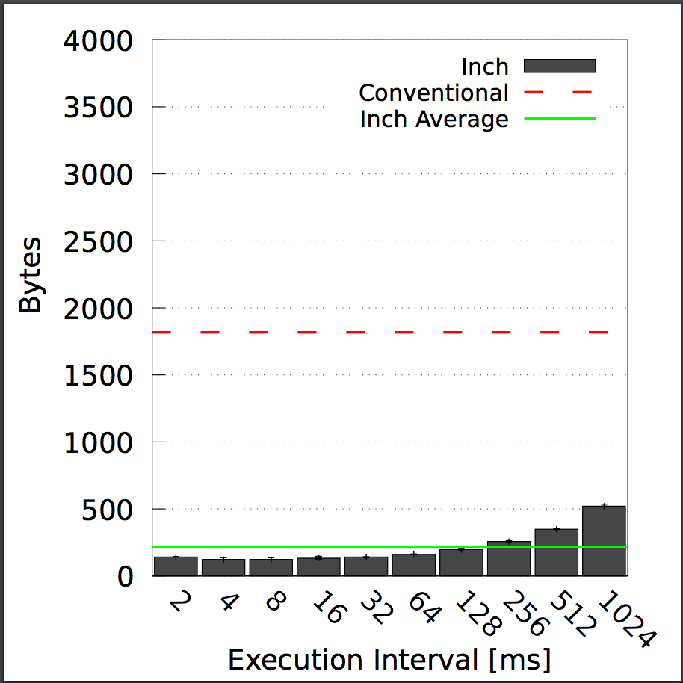
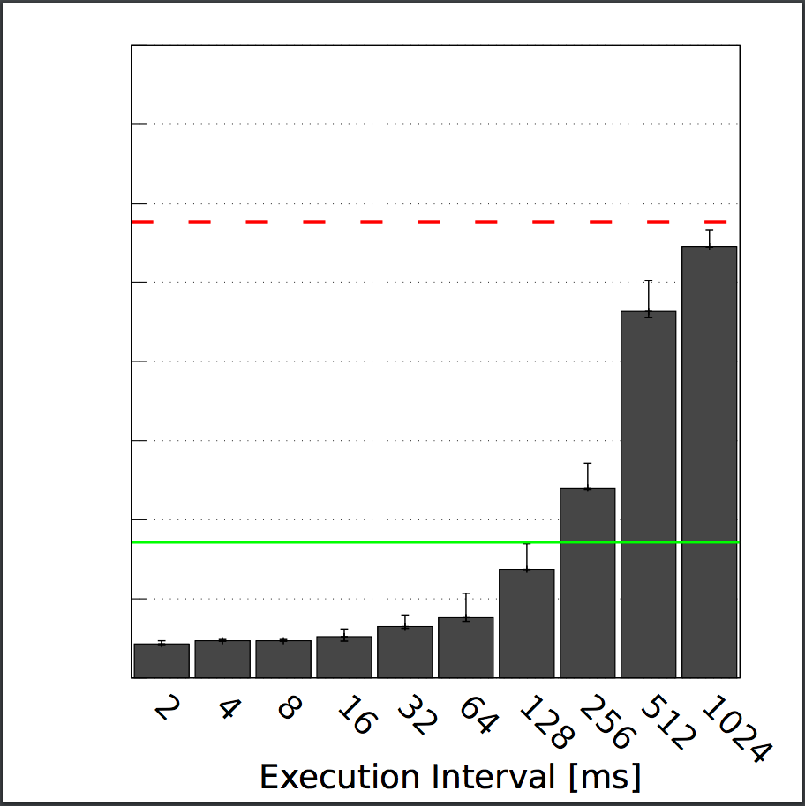
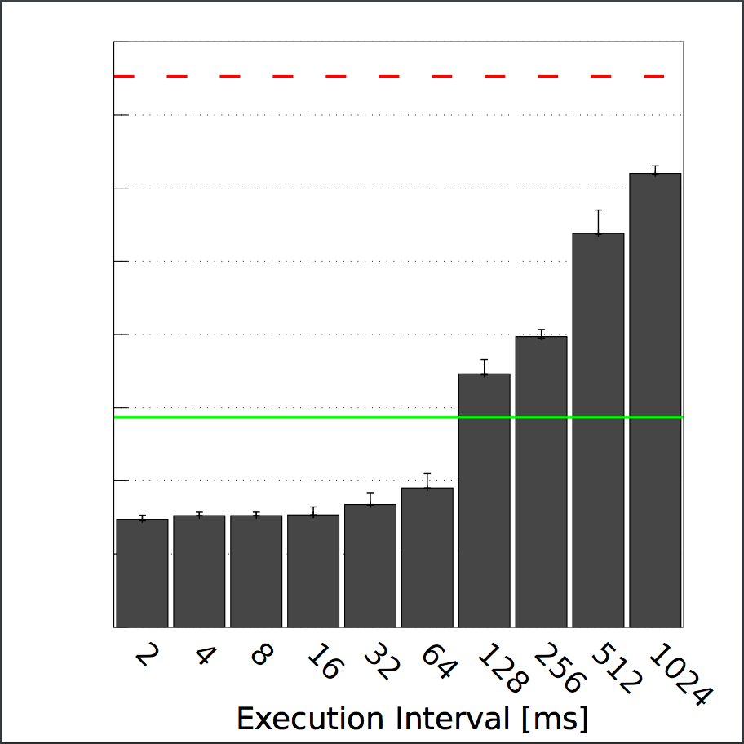
INCH - Detailed Results Contd.
Checkpoint Size:
Size-Sense
Size-FFT
Size-Size

Slide 21
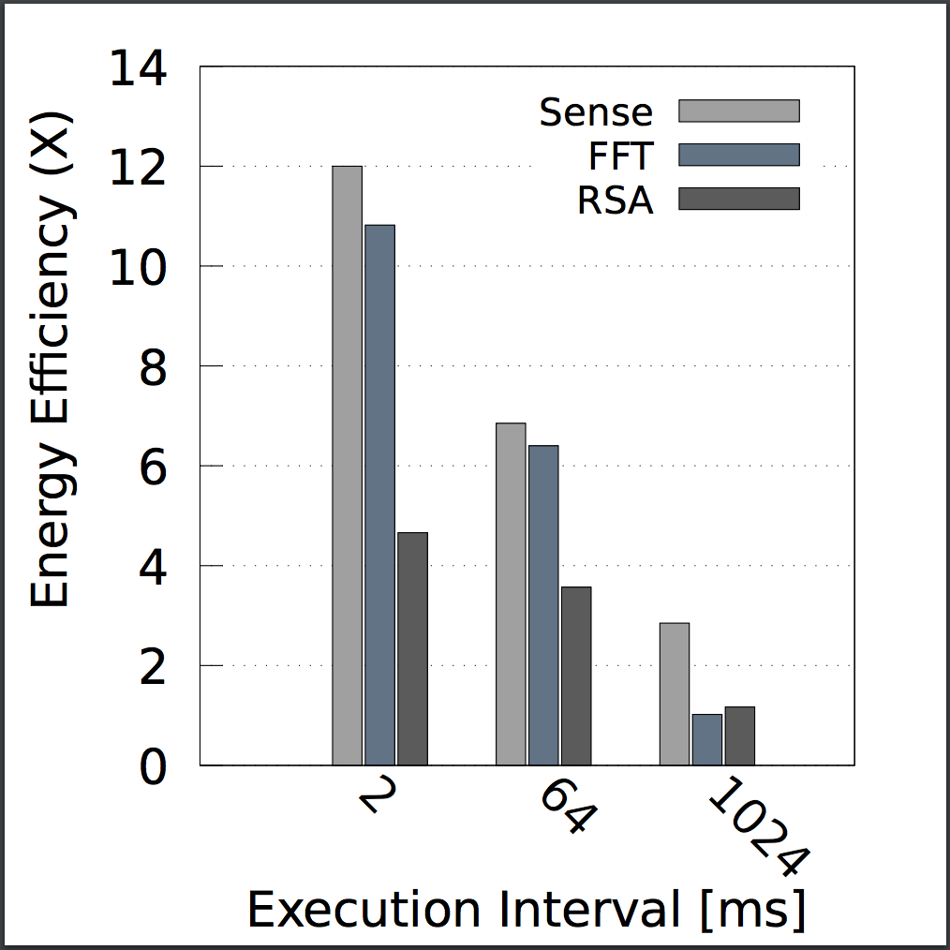
INCH - Detailed Results Contd.
Energy Efficiency:

Slide 22
Limitations
Time of interruption for checkpoint
Additional computations

Slide 23
Current Research Work
Working to port INCH to other platforms and evaluate another approach for state retention
I am also working with Dr.Suleman Shahid on the project titles as “Assistive learning Environment for Autistic Children”

Slide 24
Concerns for Checkpointing
“When to checkpoint” is still unanswered
Read/write of non consecutive bytes are ~5x more energy expensive than read/write of consecutive bytes.
Number of times update checkpoint routine is called during the applications execution on mote.
Checkpointing algorithm should reduce the overhead of number of bytes to be updated on secondary storage after each execution cycle and correctly predicting when to checkpoint by using no/minimum additional hardware
To resolve the above mentioned issues I propose a checkpointing algorithm which exploits the behavior of application.
“Variables to code paths binding(VCPB)”

Slide 25
Prediction in VCPB
In this approach the static analyzer will find all the possible code paths(if, Switch, Functional call etc.)
Total number of modifiable bytes of global data segment in each code path will be calculated offline( in static analysis phase)
Object of data structure for particular code paths will hold a list of all the to-be modified memory addresses in that path.
A call for routine “CheckEnergyLeft(nextCodePath)” will be added before the execution of any code path(parser will edit the source code before installation) and feasibility of checkpoint will be calculated( most probably would be in-line assembly to reduce the operation cycles of MCU)

Slide 26
Memory Write Optimization in VCPB
To avoid non consecutive bytes write on secondary storage I propose the following method.
We will run the application on mote multiple times and after specific time intervals the address of the modified locations will be sent to PC (via serial bus comm.)
After learning the behavior of the application the linker will relocate the variables to be consecutive that are mostly modified in test runs

